Slide 1
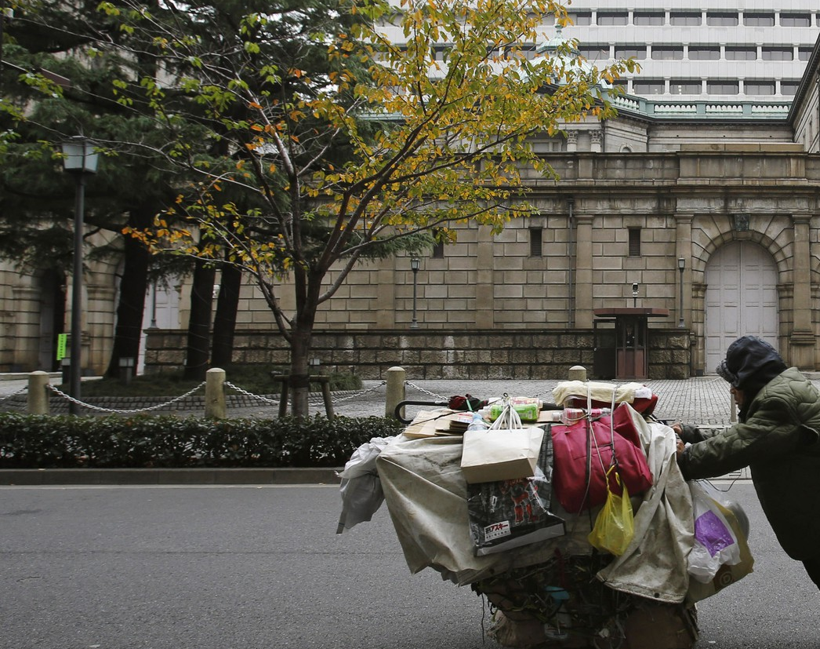
Homelessness in the US

Slide 2
Intro slide – What is the issue?
% of homeless population as portion of CoC population bar chart
Funding per CoC per homeless per capita
PIT data on unhoused population per CoC

Slide 3
Bubble map
PIT data on unhoused population per CoC

Slide 4
Snapshot of 10 largest CoC/cities
Bar Chart % of unhoused per total population in 10 largest CoC
Breakdown by demographics per city in pie charts (male/female; Age groupings; Veteran Status)

Slide 5
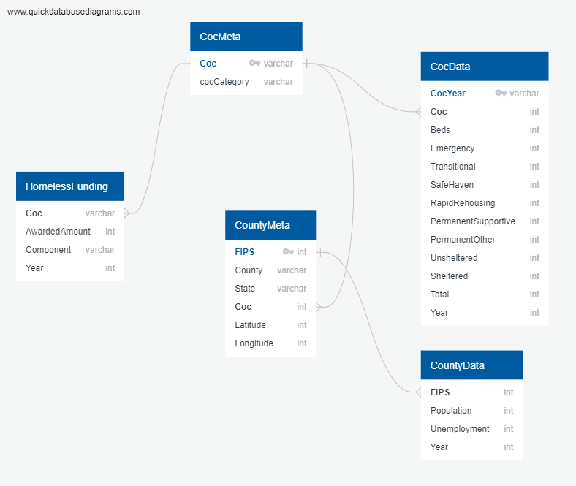
ERD of database

Slide 6
Awards per year for CoCs
Bar chart of funding per CoC (allow sorting by CoC category and possibly state)

Slide 7
ML Findings
Read in data from ML output to use to make visuals

Slide 8
ML Findings #2
Read in data from ML output to use to make visuals

Slide 9
Resources
https://homelessstrategy.com/the-20-continuums-of-care-with-the-largest-homeless-populations-in-the-u-s-public-housing-agencies-and-programs-and-homeless-admission-preference/

